Slide 1

Chapter 4: Probability

Slide 2
Probability… it’s all around us!
Real Estate: measuring the variables and developing a regression model to forecast the effect on property values.
Information Systems: using patient data to predict their health risks and developing alert systems to notify stakeholders.

Slide 3

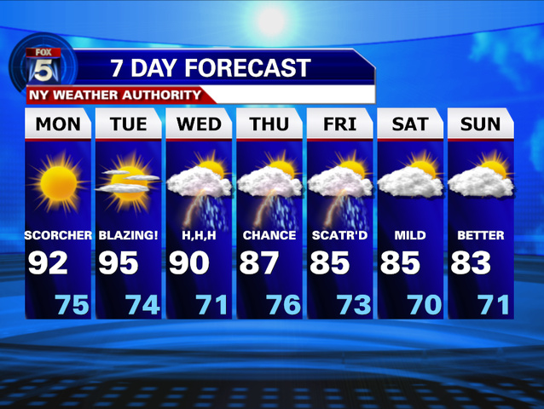

Assigning Probabilities
Classical Method
Assigning probabilities based on the assumption
of equally likely outcomes
Relative Frequency Method
Assigning probabilities based on experimentation
or historical data
Subjective Method
Assigning probabilities based on judgment

Slide 4
Principles Of Probability Where are we headed today?
The Concept of Probability
Sample Spaces and Events
Some Elementary Probability Rules
Conditional Probability and Independence
Bayes’ Theorem
Dependent vs. Independent Trials
Counting Rules

Slide 5

Why Do We Need to Quantify Probability?

Slide 6
Concept of Probability
Experiment
Process of Observations
Uncertain Outcomes

Slide 7
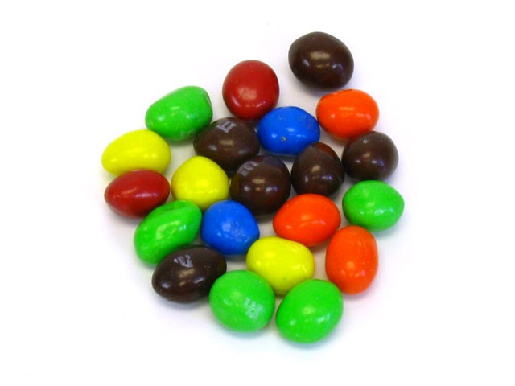
Setting up a probability experiment:
P(A) = Number of ways an event can occur (or outcomes of an experiment)
Total number of outcomes possible
Question:
If I asked you to choose 1 M&M from this pile (21 total) with your eyes closed. What is the probability that it would be a green M&M?
5
21

Slide 8
Experiment
Experimental Outcome
Probability = chance of observing a particular experimental outcome

Slide 9

Conditions
E = experimental outcome
P(E) = probability that E will occur
0 ≤ P(E) ≤ 1 such that:
P(E) = 0 if E can never occur
P(E) = 1 if E is certain to occur
The probabilities of all the experimental outcomes must sum to 1

Slide 10
Event
An event is a set of sample space outcomes
P(A)
Example Event A: P(A) = Picking a Green M&M
The complement (Ā) of an event A is the set of all sample space outcomes not in A
P(Ā) = 1 – P(A)

Slide 11


Venn Diagram
= 21 M&M’s
P(A) = Picking a green M&M
P($\overline{A}$) = Not picking a a green M&M
A
0.24
$\overline{A}$
0.76
= 1.00
5/21
16/21

Slide 12


A Little More Complicated:
What are all the possible outcomes for choosing a beverage?
OR
?
Pants
Skirt

Slide 13
Probability
1.
= 1/4
3.
= 1/4
2.
= 1/4
4.
= 1/4

Slide 14
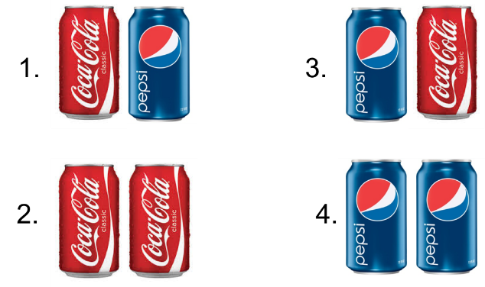
Event, con’t
An event is a set of sample space outcomes
Example Event: P (A) = Pants chooses coke
Notes:
More pictures

Slide 15
Probability of the event
The probability of an event is the sum of the probabilities of the sample space outcomes
Example Event: P (A) = Pants chooses coke
P(A):
1/4
+
1/4
= 1/2

Slide 16
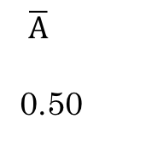
Venn Diagram
1/4
+
1/4
Example Event: P (A) = Pants chooses coke
A
0.50
$\overline{A}$
0.50
= 1.00

Slide 17
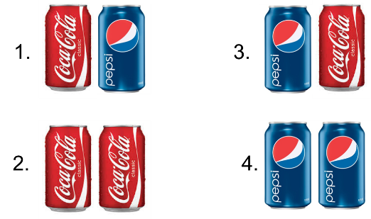
More Examples:
P(A) = At least one person chooses Coke
P(A) ¼ + ¼ + ¼
P(A) = ¾ or .75 or 75%

Slide 18

More Examples
Event B: Exactly one person likes Pepsi
P(B) ¼ + ¼
P(B) = ½ or 50%

Slide 19
Your Turn!
If you roll a fair dice, with sides labeled A,B,C,D, E, and F. What is the probability the dice lands on a vowel?
Simplify your final answer.

Slide 20



Please download and install the Slido app on all computers you use
If you roll a fair dice, with sides labeled A,B,C,D, E and F. What is the probability the dice lands on a vowel?
ⓘ Start presenting to display the poll results on this slide.

Slide 21
Some Elementary Probability Rules
Intersection
Union
Addition
Conditional probability
Multiplication

Slide 22
Intersection
The intersection of events A and B (A ∩ B)
events that belong to both A and B

Slide 23

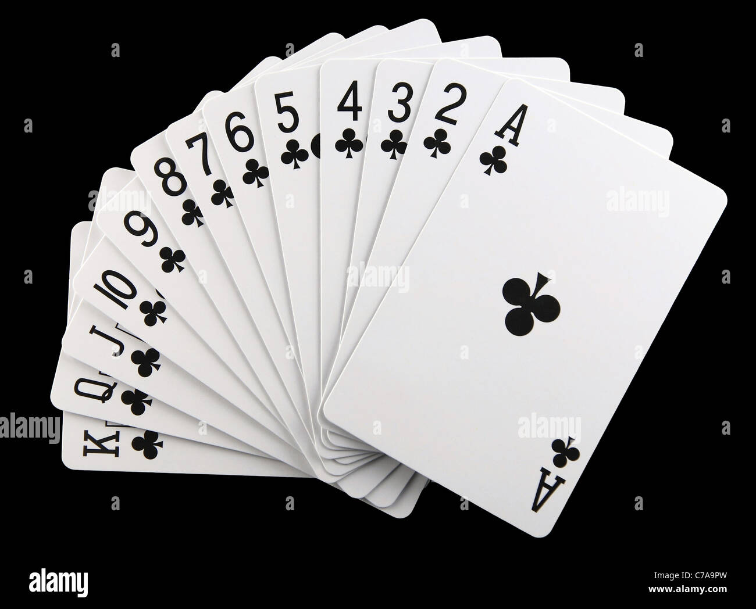
Rules of Probability - Intersection
P(A) = Pulling an ace from a deck of cards
P(B) = Pulling a club from a deck of cards
A
B
= 1.00
“Probability of A and B”
Pulling an Ace of Clubs
P(A ∩ B)

Slide 24
Rules of Probability - Union
P(A) = Pulling an ace from a deck of cards
P(B) = Pulling a club from a deck of cards
“Probability of A or B or both”
A
B
= 1.00
P(A ∪ B)

Slide 25
More Than One Event
Event A: Pants Chooses Coke
Event B: Skirt Chooses Pepsi
A
B

Slide 26
Addition Rule (not mutually exclusive)
Pants Chooses Coke and Skirt Chooses Pepsi
beware of double counting the common element !
A
B
P(A ∪ B) = P(A) + P(B) – P(A ∩ B).

Slide 27
Mutually Exclusive
A and B are mutually exclusive if they have no sample space outcomes in common
In other words: P(A∩B) = 0
(only allowed to choose one drink)
P(A) = Skirt chooses Pepsi
P(B) = Skirt chooses Coke
Ā and A are always mutually exclusive:
A
B

Slide 28
Addition Rule P(A ∪ B) = P(A) + P(B) – P(A ∩ B).
Anthony feels that he has a 75% chance of getting an A in statistics and a 55% chance of getting an A in managerial economics. He also believes he has a 40% chance of getting an A in both classes.
What is the probability that he gets an A in at least one of those courses?
What is the probability that he does not get an A in either of these courses?

Slide 29

Please download and install the Slido app on all computers you use
What is the probability that he gets an A in at least one of those courses?
ⓘ Start presenting to display the poll results on this slide.

Slide 30
Please download and install the Slido app on all computers you use
What is the probability that he DOES NOT get an A in at least one of those courses?
ⓘ Start presenting to display the poll results on this slide.

Slide 31

Multiplication Rule (Conditional Probability)
P(A∩B)
What does this mean conceptually?
Probability should be smaller than P(A ∪ B)

Slide 32
Conditional Probability
Suppose an event B has already occurred P(B)>0
(i.e. probability a company’s stock prices will go up conditional to higher-than-expected profits)
That may change the probability of future event A.
Conditional probability of A given B = probability that A occurs given that B has occurred.
Denoted as P(A|B)

Slide 33
Conditional Probability (Multiplication Rule)
Recall: P(A ∩ B)
P(A ∩ B) = P(A) ∙ P(B│A)
Or
P(A ∩ B) = P(B) ∙ P(A│B)
“Probability of B Given that A has occurred”
“Probability of A Given that B has occurred”

Slide 34
Independence of Events
Sometimes, even if event B has occurred, that does not affect the probability of A.
In that case A and B are said to be independent
P(A|B) = P(A)
This is equivalent to P(B|A) = P(B)
Assume P(A) and P(B) are greater than 0

Slide 35
Multiplication Rule
In Case of Dependent Events:
In Case of Independent Events:
P(A∩B) = P(A)*P(B)
P(A∩B) = P(A)*P(B|A)
OR
P(A∩B) = P(B)*P(A|B)

Slide 36
Reworking the Formula
P(A∩B) = P(A)*P(B|A)
P(A) P(A)
P(B|A) = P(A∩B)
P(A)

Slide 37
Sample Problem # 1
Economic globalization is defined as the integration of national economies into the international economy through trade, foreign direct investment, capital flows, migration, and the spread of technology. Although globalization is generally viewed favorably, it also increases the vulnerability of a country to economic conditions of the other country. An economist predicts a 60% chance that country A will perform poorly and a 25% chance that country B will perform poorly. There is also a 16% chance that both countries will perform poorly.
What is the probability that country A performs poorly given that country B performs poorly?
What is the probability that country B performs poorly given that country A performs poorly?
Interpret your findings.

Slide 38
Sample Problem # 2
John and Jane are married. The probability that John watches a certain television show is 0.4. The probability that Jane watches the show is 0.5. The probability that John watches the show, given that Jane does, is 0.3.
A. Find the probability that both John and Jane watch the show.
B. Find the probability that Jane watches the show, given that John does.
C. Do John and Jane watch the show independently of each other?

Slide 39

Bayes’ Theorem

Slide 40
Bayes’ Theorem Simplified

Slide 41
Counting Rules

Slide 42
Permutations
Number of permutations of “N” elements taken “r” at at time.
Permutations (Order is important):
with repetition:
without repetition

Slide 43
Permutation without Repetition
Number of permutations for a 3 digit lock code where digits cannot be repeated:
Number of digits for first position = 10
Number of digits for second position = 9
Number of digits for third position = 8
10 number taken 3 at a time
N= 10 and r=3.

Slide 44
Combinations
Combinations (order is not important):

Slide 45
Combinations: Example
How many ways to form a committee of 3 among 8 people ( A, B, C , D, E, F, G, H)?
Recall that in this case: Committees ABC, ACB, BAC, are the same.

Slide 46
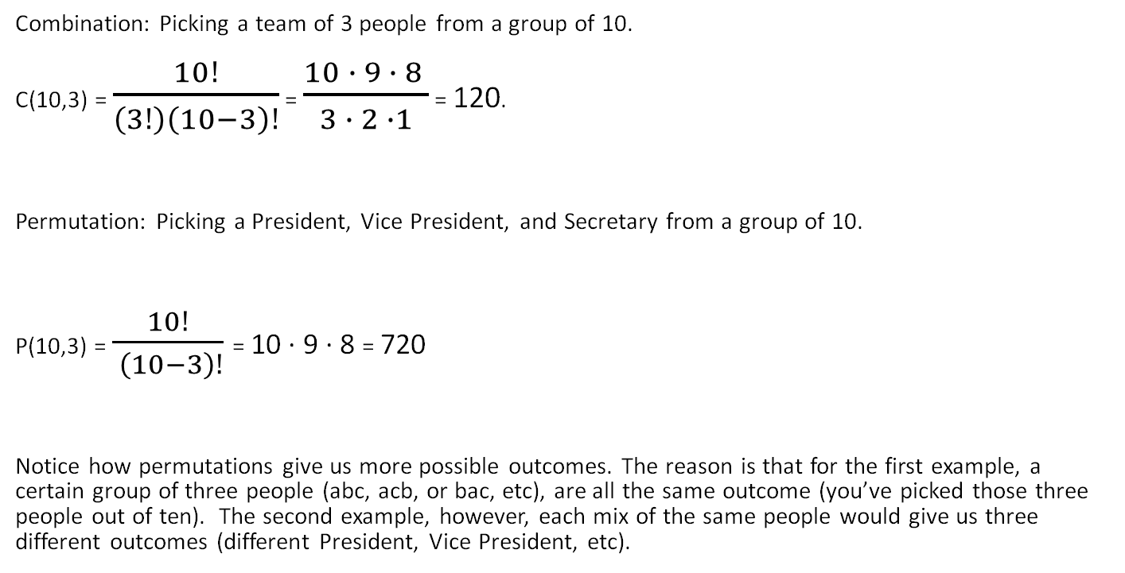
Combinations vs. Permutations Impacts the Probability of an Event
Combination: Picking a team of 3 people from a group of 10.
C(10,3) = $\frac{10!}{\left(3!\right)\left(10−3\right)!}$ = $\frac{10 ∙ 9 ∙ 8 }{3 ∙ 2 ∙1}$ = 120.
Permutation: Picking a President, Vice President, and Secretary from a group of 10.
P(10,3) = $\frac{10!}{ \left(10−3\right)!}$= 10 · 9 · 8 = 720
Notice how permutations give us more possible outcomes. The reason is that for the first example, a certain group of three people (abc, acb, or bac, etc), are all the same outcome (you’ve picked those three people out of ten). The second example, however, each mix of the same people would give us three different outcomes (different President, Vice President, etc).

